Slide 1
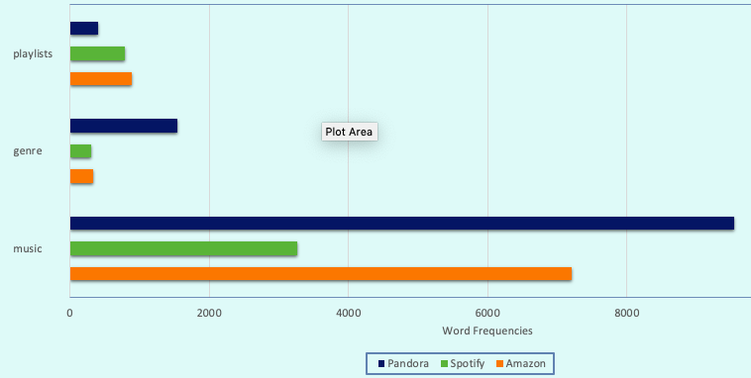
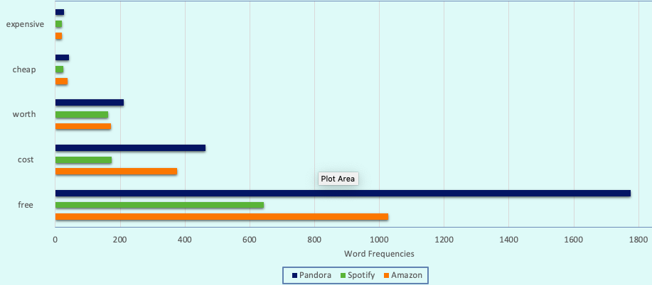
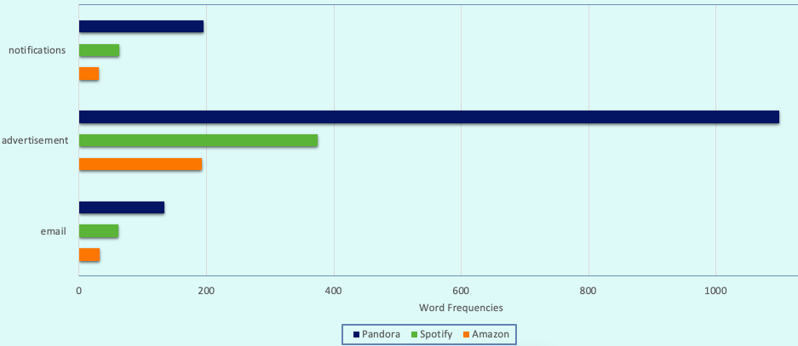
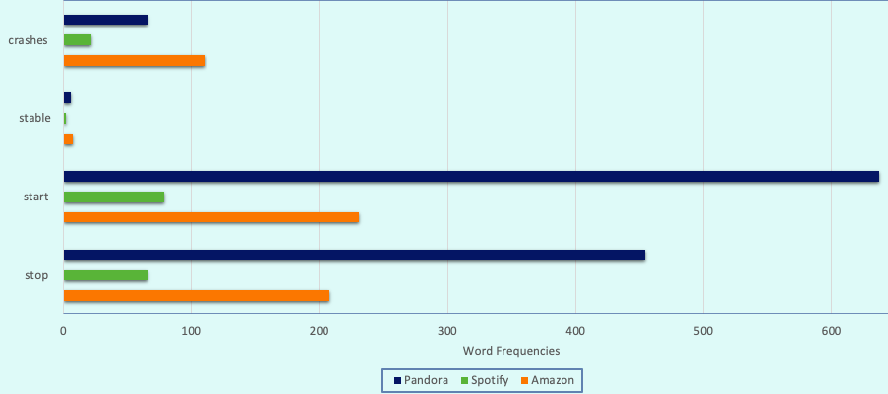
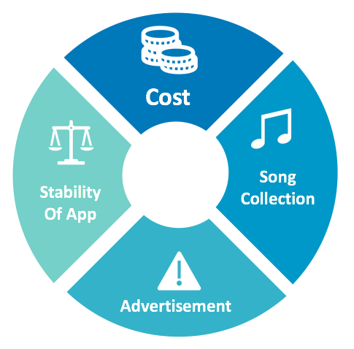


Gauging User Perception on Music Applications from Playstore using Sentiment Analysis
Soundarya Ramani, Srikanth Pendyala, Yashi Gupta Programming Analytics and Data Process, School of Information Sciences, University of Illinois Urbana Champaign
INTRODUCTION
This project aims to compare Music Applications such as Pandora, Spotify and Amazon music by using scraped data (user reviews) from Google Playstore.
Application of sentiment analysis technique using Python on user reviews. Comparison of Music applications on the basis of four essential factors such as Cost, Collection, Stability of Application and Advertisement.
Additionally, portraying a sentiment score on user in order to give the user a perception of their review on the Internet before they upload the review.
RESEARCH DESIGN AND METHODS
Website Scrapping:
Performed Web Scrapping on User reviews from the Google play store using selenium package in order to automate web browser interaction from Python. Used ChromeDriver to launch and perform tasks on Google play store.
Sentimental Analysis using VADER:
Valence Aware Dictionary and Sentiment Reasoner is a lexicon and rule-based sentiment analysis tool that is specifically attuned to sentiments expressed in social media. It uses a combination of sentiment lexicon which is a list of lexical features (e.g., words) which are generally labelled according to their semantic orientation as either positive, negative or neutral.
Aspect Based Analysis:
Analyzed each review to identify various aspects such as Cost, Collection, Advertisement and Stability of App and determined the corresponding sentiment for each of these factors. Customers are more vocal than ever. They love leaving feedback – good and bad – making them a valuable resource for businesses
Song collection:
Based on the song collection, Spotify offers great and diverse music choices. This deems our hypothesis as true since Spotify's immense music playlist collection and diverse genres with a very low subscription rate has gained competitive edge in the music industry.
RESULTS:
CONCLUSION
Our analysis on the scraped data sets shows that amazon music is the most preferred app due to its higher positive sentiment score and the. Factos that play a role in getting these positive reviews are lack of advertisements, free usage for prime subscribers. Both cost and advertisements play a major role in amazon music being the dominant music app.
Cost
Amazon music and Pandora being free provide a wide range of music and also gains immense attention in the market.
FUTURE WORK
Our future work would include creating an interface to take in user input in the form of reviews after which we would give them a feedback with the sentiment score of their input as negative, positive or neutral to tell them the effect of their review on a particular application.
Advertisement & Spam
Pandora's free version gains more attention in the market within a certain age range although its advertisements can act as interruptions which also proves our hypothesis true.
ACNOWLEDGMENT
This material is based on the work supported by the School of Information Sciences at the University of Illinois under the course IS590PR taught by Sr. Instructor John Weible and his expert assistance.
LITERATURE REVIEW
Music apps have revolutionized the way people listen to music in this era. Music apps have provided artists and audiences with a platform to share content and enjoy music
In this growing age of technology and music where there is cut throat competition and plenty of options for the users to listen from, user reviews and their impact play a more significant role than ever.
Our aim through this project is to see what user preferences are through an analysis of their reviews and see which app garners the maximum levels of satisfaction.
.
REFERENCES
TheDancerCodes. "TheDancerCodes/Selenium-Webscraping-Example." GitHub. September 04, 2017. Accessed April 24, 2019.
Taracha, Roger, and Roger Taracha. "Introduction to Web Scraping Using Selenium." Medium. September 04, 2017. Accessed April 24, 2019.
Application Stability
Applications like Amazon Music are highly unstable and can crash devices.

